Slide 1


Wath
Academy
Year 6 / Year 7 Summer School 2021
Wath meets Tokyo Olympics 2021!

Slide 2


WATH ACADEMY| Wath Meets Toyko Olympics 2021!
Relationships
Enrichment
Experiences
2021
Memories!

Slide 3






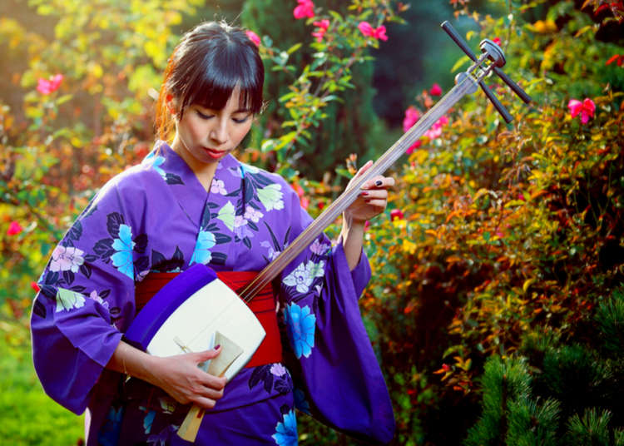

WATH ACADEMY| Wath Meets Toyko Olympics 2021!
Anime and Manga!
Science
Experiments!
Spanish!
THE OLYMPICS!
Drama!
Sushi Making!
Music!
Art!
And much more…!

Slide 4

WATH ACADEMY| Wath Meets Toyko Olympics 2021!
Interested?
A letter has been put on the Wath Academy website, with a link to a Microsoft Form that your parents/carers can fill in if you would like to take part.
More information will then be sent to your parents/carers towards the end of the school term.
Form deadline: Sunday 4th July
We look forward to seeing you in Summer!!

